Slide 1
The Data Model, PowerPivot and Dashboards
Notes:
This workshop you explore data models, PowerPivot, and Power View, using Microsoft Office Excel 2013.

Slide 2
Objectives
Understand the basics of dashboard design
Explore the new data model
Create advanced data models using PowerPivot
Create PivotTables and PivotCharts with PowerPivot
Notes:
The objectives of this chapter are:
Understand the basics of dashboard design
Explore the new data model
Create advanced data models using PowerPivot
Create PivotTables and PivotCharts with PowerPivot
The objectives continue on the next slide.

Slide 3
Objectives
Use Apps for Office for data visualizations
Prepare a dashboard for production
Generate visual reports with Power View
Notes:
Additional objectives include:
Use Apps for Office for data visualizations
Prepare a dashboard for production
Generate visual reports with Power View

Slide 4
Understand the Basics of Dashboard Design
Business intelligence (BI)–software applications used to analyze organization’s data for management decision making
Digital dashboards–deliver BI in graphical format
Notes:
Businesses collect data each day, and that data has the potential to provide valuable information to assist in decision making. Business intelligence, or BI, involves using a variety of software applications to analyze the organization’s data to enable management to make good decisions, cut costs, and take advantage of new opportunities.
Digital dashboards support BI by providing information in a visual or graphic format. Think of the dashboard of your car and the information it provides at a glance, and how that affects your driving. Running low on fuel? You decide to pull into a gas station. Driving too slow? You decide to speed up. Check engine light on? You make an appointment at the garage. Now equate that to business, and you can see that a digital dashboard would help management “drive” the business by making decisions based on the information provided.
In the following slides, information to help you understand the basics of dashboard design will be covered.

Slide 5
Understand the Basics of Dashboard Design
Dashboard:
Single screen
Visually oriented
Intuitive, easy to navigate
Interactive controls for customization
Integration of multiple data types
Data frequently updated
Information oriented around specific problem
Extra training not required
Notes:
Effective dashboards have characteristics that make them easy to use, while providing information that the user needs, when they need it. Generally dashboards are displayed on a single screen, which is visually oriented and intuitive to operate. Interactive controls enable the user to customize the interface.
Data flows into the dashboard interface frequently to provide the most up-to-date view of the data. In many cases, the dashboard provides just the data view that users need, and is oriented around a specific problem on which that person makes a decision. The dashboard should also be so intuitive that additional training is not required in order to effectively use the interface.
The following slide describes design principles for dashboards.

Slide 6
Understand the Basics of Dashboard Design
Keep it simple
Make sure it is well defined
Know your users
Define key performance indicators (KPI)
Use strategic placement
Design with white space
Notes:
The principles of dashboard design are very similar to other types of design. Keep it simple so that users can easily navigate and interpret the dashboard. Make sure the dashboard is well defined by focusing on a specific business problem. As you design a dashboard, keep in mind that users want and need different information. Involve the users early in the design process so that you can develop an effective dashboard that meets their needs.
Long-term and short-term goals help management gauge their progress. Identify key performance indicators, such as sales growth, customer satisfaction, market share, turnover rates, and on-time delivery. The key performance indicators suggest the types of information that should be easily available via the dashboard.
Strategic placement refers to the layout of the elements on the dashboard so that it has an impact on usability. Many people think that the more you can put on the screen, the better the interface is, but in reality, white space can make a dashboard much more visually appealing, accessible, and easier to use.
While there are many commercial products available for creating dashboards, Excel enables you to create dashboards with minimal costs. For many people within the company, Excel will be a familiar tool, making the transition to using the dashboard easier. Excel is also flexible in that there are many different analytics, such as PivotTables, Form controls, and Power View, to provide views of data. Using Excel you can rapidly produce reports and have the flexibility to change them as requirements change.

Slide 7
Explore the New Data Model
Data model–collection of tables and relationships
Relational data–data about person, place, or thing stored in multiple tables
Sources:
Access database
SQL Server
Text file
SharePoint list
Notes:
Businesses use data models to show the real-world relationships between business functions and processes. The data models contain tables of data that have relationships. For instance, a customer table may be related to revenue and sales volume tables. In the past, relational data was stored in databases, but it was difficult to perform analyses on that data. With Excel 2013, the data about people, places, and things can be stored in tables and used as data models. There are many sources of relational data, including Access databases, SQL Server databases, text files, and SharePoint lists. By creating a connection to the data source, you can import data from these sources.
On the following slides, creating a data model will be discussed.

Slide 8
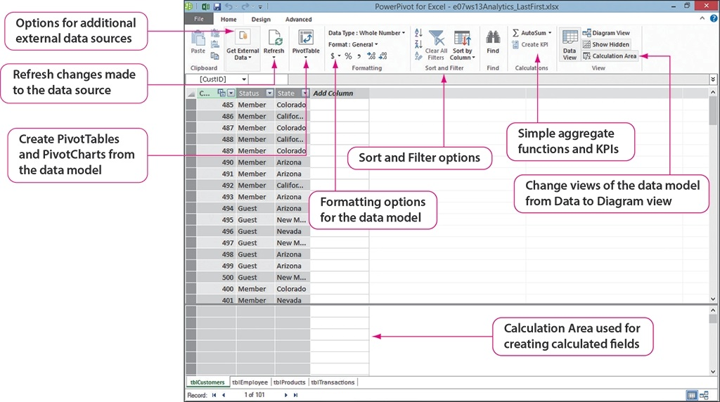
Explore the New Data Model
Notes:
To integrate data from multiple tables, the PowerPivot COM Add-In is required in Excel. Use the Backstage view Options to add the PowerPivot tab to the Ribbon. After installing the tab, click Manage to open the PowerPivot window shown here. This window is separate from the workbook window, with each table appearing on a separate worksheet. The Home tab of the PowerPivot window enables you to do things such as add new data from data sources, refresh the data model, and create PivotTables and PivotCharts. You can format, sort, and filter the data on the Home tab, as well as create simple calculations and key performance indicators (KPIs). Using the Home tab, you can change the view of the data.
Notice that there are only three tabs on the PowerPivot window. On the Design tab, you can modify table properties, create more complex calculated fields, create and edit relationships between worksheets, and more. Using the Advanced tab, you can change the data perspectives to more closely meet the needs of various users or to help them interpret the problem more easily.
The following slide discusses using PowerPivot to view relationships in the data model.

Slide 9
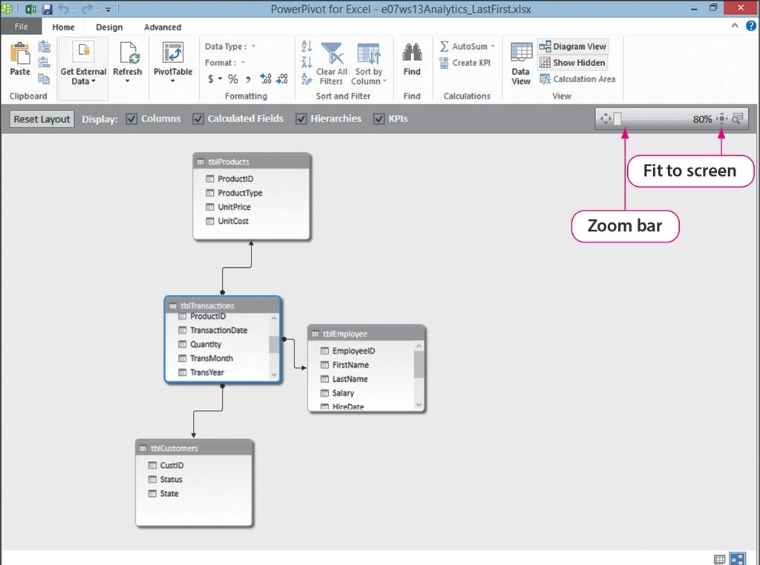
Explore the New Data Model
Notes:
Using the Home tab, click Diagram View to see the relationships among the tables that have been imported into PowerPivot, as shown here. In this figure, one table is related to the other three tables, and the columns, representing fields of the table, are shown for each table. Tools in the Diagram View enable you to zoom and fit the relationship diagram to the screen. Keep in mind that data can be added to the data model when needed and the relationships will be updated.

Slide 10
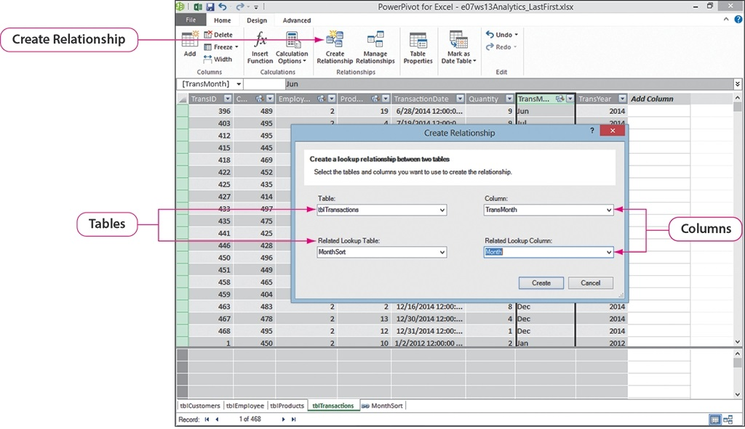
Create Advanced Data Models Using PowerPivot
Notes:
As data is imported into PowerPivot, only the data that has predefined relationships are imported into the data model. As you add data to the model, you must create the relationships between the appropriate tables using the Create Relationship dialog box, as shown here. Specify the tables that relate, along with the related column. After updating the relationships, you can reset the layout to include all of the relationships in the data model, using the Diagram View.
Information on using PowerPivot to create advanced data models continues on the next slide.

Slide 11
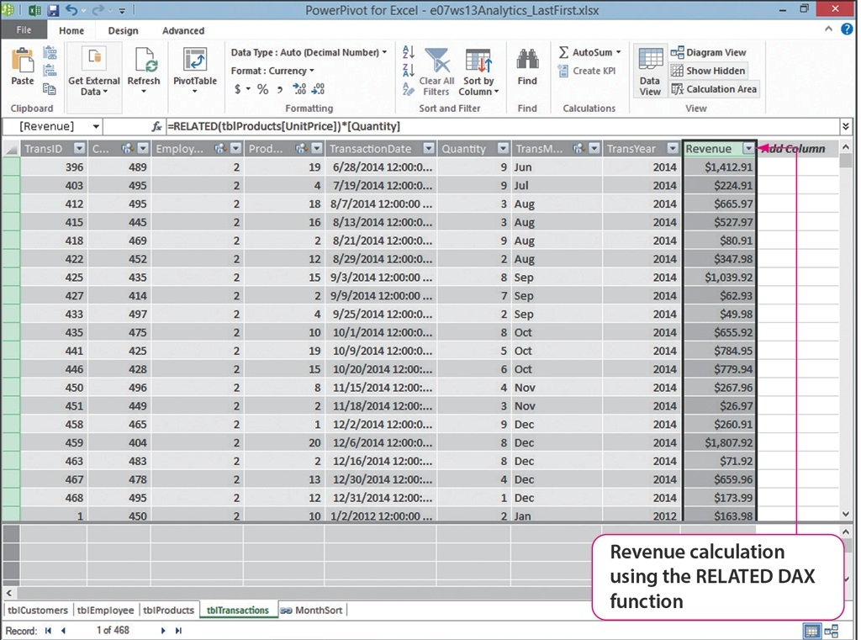
Create Advanced Data Models Using PowerPivot
=RELATED(tblProducts[UnitPrice])*[Quantity]
Notes:
Calculated columns, based on the data in the data model, can be added using the PowerPivot window, as shown here. The RELATED function can only be used in PowerPivot. Using the relationships in the data model, it retrieves the UnitPrice from the Products table in much the same way as the LOOKUP function works. Additional columns with more calculations can be added to the data model as needed. The RELATED function can also be used to concatenate fields.
The RELATED function belongs to a category of functions called Data Analysis eXpressions, or DAX. You will find date, time, mathematical, trigonometric, statistical, text, logical, filter, information, and parent/child DAX functions available for use in PowerPivot.
The discussion of creating advanced data models using PowerPivot continues on the next slide.

Slide 12
Create Advanced Data Models Using PowerPivot
Calculated fields:
Implicit calculated field
Drag field into Values area
Functions: AVERAGE, SUM, COUNT, MAX
New field not created
Explicit calculated field
Formula typed in Calculation area
Wide variety of functions available
Notes:
As you have seen, columns can contain calculations. Often, you will also add a calculated field, such as a sum or other aggregation of a values, to a data model in the Values area. There are two types of calculated fields: implicit and explicit. When you drag a field into the Values area of a PivotTable, an implicit calculated field is created. Functions such as AVERAGE, SUM, COUNT, and MAX are used for implicit calculated fields. With implicit calculated fields, a new field is not created, only the calculation takes place in the Values area.
Explicit calculated fields require a function, which is typed into the Calculation area of the PowerPivot window. This enables you to use a wide variety of functions.
A worksheet showing these two types of calculated fields follows on the next slide.

Slide 13
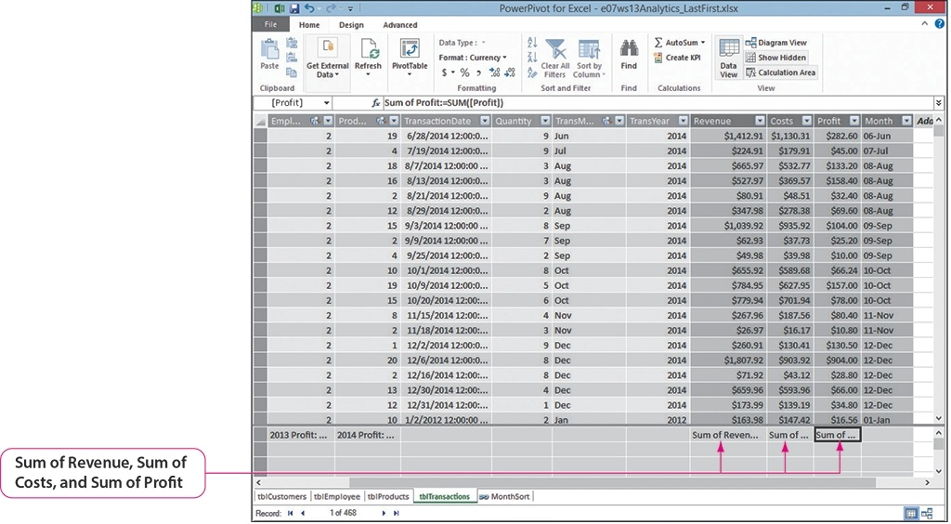
Create Advanced Data Models Using PowerPivot
Notes:
This figure displays calculated fields at the bottom of the columns. The first two columns have an explicit CALCULATE function applied to create the sum of the profits for 2013 and 2014. The remaining column totals were created using AutoSum.
More information on creating advanced data models continues on the next slide.

Slide 14
Create Advanced Data Models Using PowerPivot
Key performance indicators:
Base value
Target value
Status threshold
Positive KPI
Negative KPI
Bidirectional KPI
Notes:
Key performance indicators enable managers to gauge benchmarks within the organization. Using PowerPivot you can create KPIs using base values, target values, and status thresholds. A base value is a calculated field that resolves to a value. In the last example, the profit column calculated fields were examples of base values. Target fields can be calculated fields that resolve to a value or an absolute value, such as a sales goal required by management. The status threshold is the range between a high and low value, which is displayed as a graphic in Excel.
A positive KPI indicates that a value is better than the KPI, while a negative KPI is the reverse, with the value being less than the KPI. A bidirectional KPI occurs when the value becomes worse when it deviates too far from the target value in either direction.
The discussion of KPIs continues on the next slide.

Slide 15
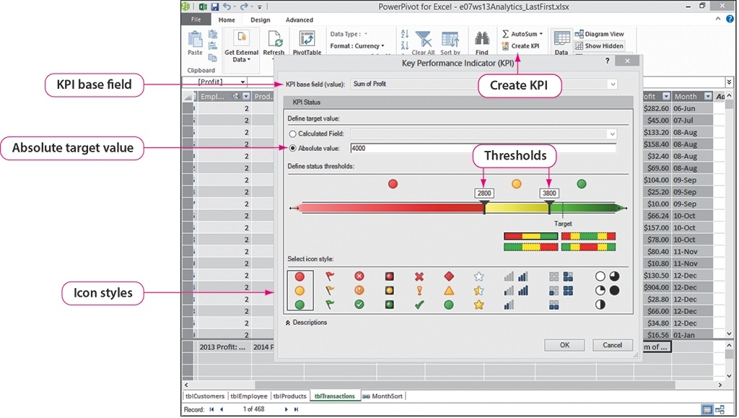
Create Advanced Data Models Using PowerPivot
Notes:
Using Create KPI on the Home tab of the PowerPivot window, the target value field is set to the absolute value of 4,000 in this example. The status thresholds are set using the sliding bars and icon styles can be selected. The KPI indicator will appear to the right of the field selected when the KPI process was begun, in this case the Sum of Profit field. The KPI can also be set using a calculated field as the target value, such as yearly profit.

Slide 16
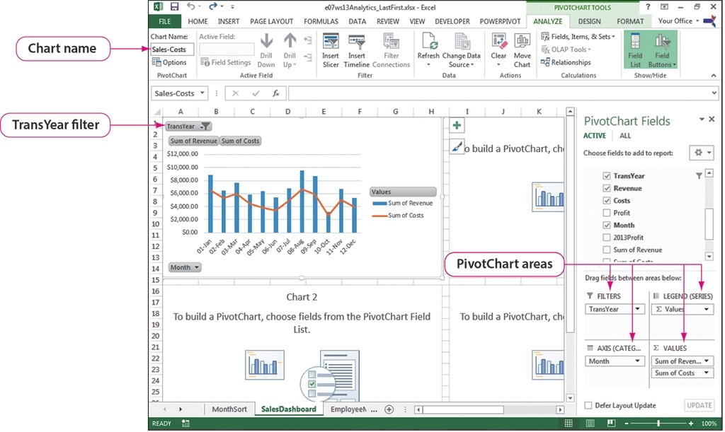
Create PivotTables and PivotCharts with PowerPivot
Notes:
PowerPivot extends your capability to create PivotTables and PivotCharts using data with multiple sources. You can create a dashboard with multiple PivotCharts and PivotTables to inform management at a glance. In this example, four PivotCharts were added to the dashboard, with the first being populated with a Combo chart comparing the sum of revenue against the sum of the costs for the year 2012. Additional PivotCharts will be added to this dashboard that compare sum of revenue against the sum of costs for the years 2013 and 2014. An Employee-Sales Bar chart will show revenue generated by each employee from 2012 to 2014.
After creating the PivotCharts, improvements can be made to the charts by changing the styles, adding titles, changing formats, and more. Keep in mind that easy-to-understand charts translate into better decisions based on the data.
The discussion of creating a dashboard using PowerPivot continues on the next slide.

Slide 17
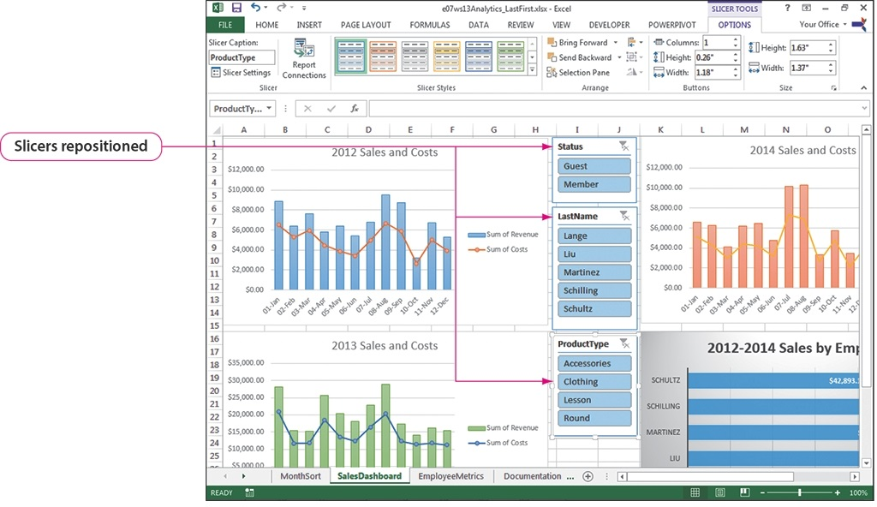
Create PivotTables and PivotCharts with PowerPivot
Notes:
Slicers, added to the dashboard, enable users to interact with the data by filtering. Slicers are added to dashboards to increase their functionality and give the users more options and access to data. Once created, using the Analyze tab, the slicers can be manipulated by resizing and repositioning them, as shown here. Keep in mind that multiple fields can be selected from the slicers by holding Ctrl while clicking each field.
More information on creating a dashboard with PowerPivot continues on the next slide.

Slide 18
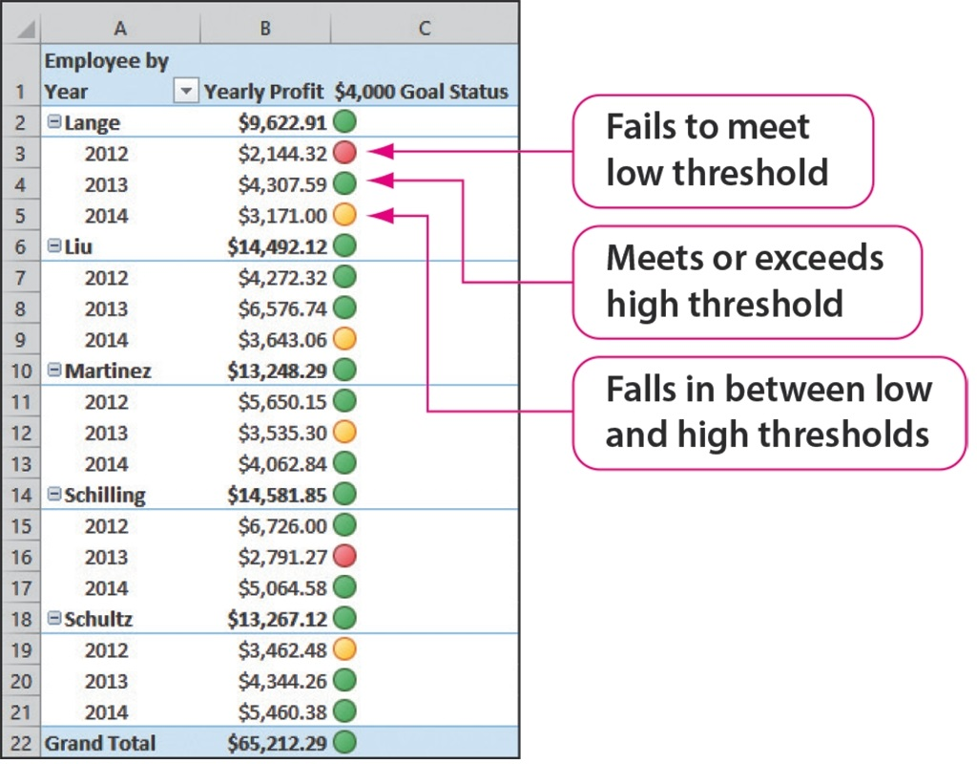
Create PivotTables and PivotCharts with PowerPivot
Notes:
In an earlier slide, we discussed setting up key performance indicators. These can be added to the dashboard to allow for additional analysis. Shown here is a yearly profit KPI, showing the yearly sales for each employee. Note that the indicators report the status thresholds in a graphic format of different colored circles. Also notice the Grand Total for the column contains a status threshold indicator.
More information on using KPI on the dashboard continues on the next slide.

Slide 19
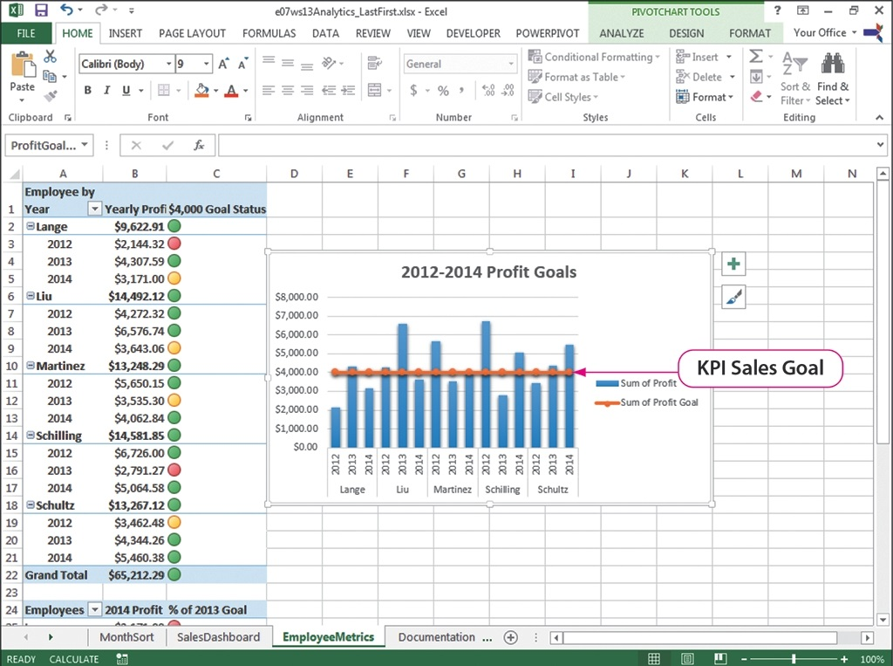
Create PivotTables and PivotCharts with PowerPivot
Notes:
KPIs can also be added to charts, to further enhance the visual information they provide. As shown here, the KPI Sales Goal has been added to the 2012-2014 Profit Goals chart. At a glance, managers can see the years in which sales people excelled or fell short of their goals.
The discussion of creating PivotTables and PivotCharts with PowerPivot continues on the next slide.

Slide 20
Create PivotTables and PivotCharts with PowerPivot
Notes:
Sparklines are miniature charts that summarize a row or column of data in a single cell, as shown here in the far right column. This is yet another way to provide quick-to-understand data to managers. Sparklines are added using the Insert tab.

Slide 21
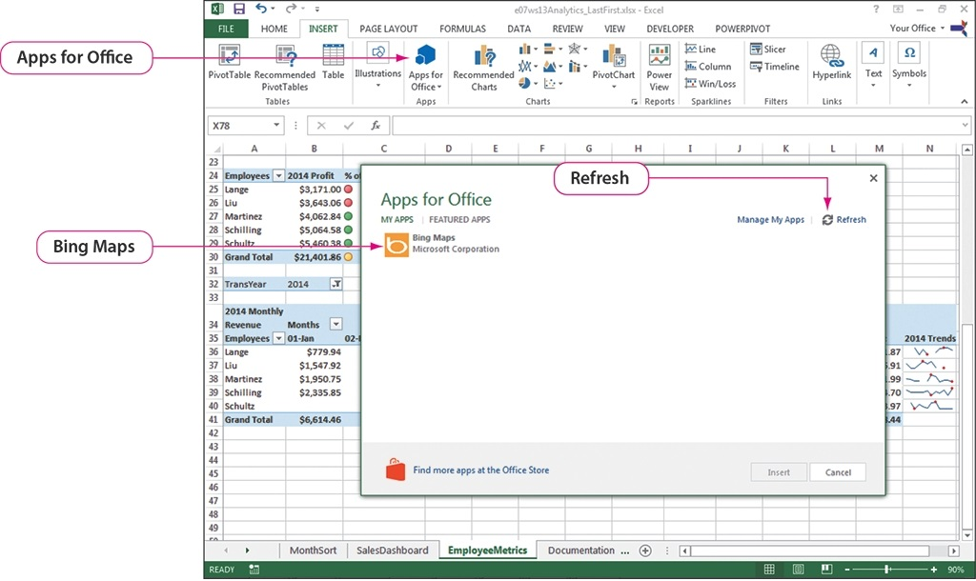
Use Apps for Office for Data Visualizations
Notes:
Dashboards can be enhanced using apps for Office, which is a new feature to Office 2013. An app for Office is a web page hosted inside of an Office application, such as Excel. Use the Insert tab to install apps, after signing into your Microsoft account. You can select from a wide variety of apps, including Sticky Notes for Office, Currency Converter, Mini Calendar and Date Picker, Bing Maps, and more. Be careful to select apps that enhance your dashboard, ones that assist managers in their decision making. As shown here, you can view your apps (using My Apps), view Featured Apps, and search for apps at the Office Store.
On the following slide, using the Bing Maps app is discussed.

Slide 22
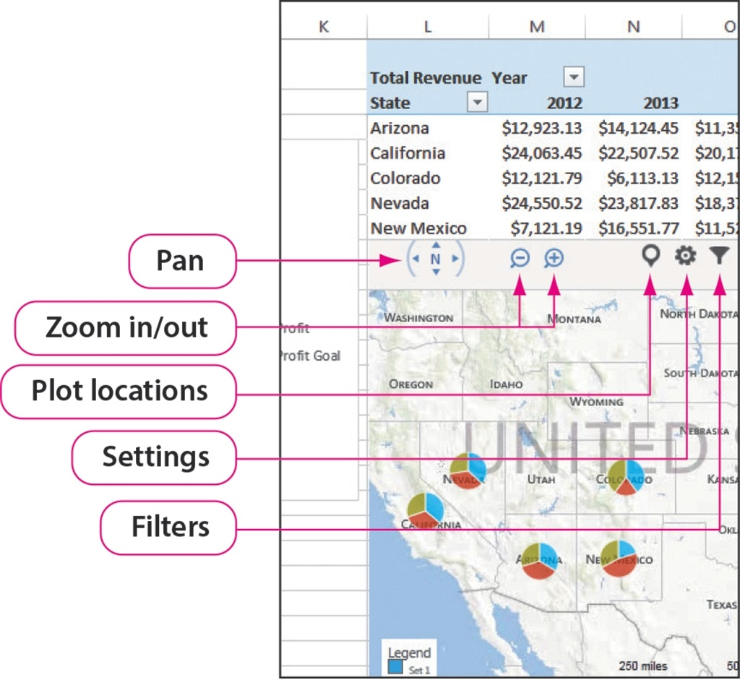
Use Apps for Office for Data Visualizations
Notes:
Demographic information can be tracked on Bing Maps, making it more user-friendly, as shown here. The data can be plotted on the map, and in this case the yearly sales for each state are plotted in pie charts. Again, this provides visual clues to the managers, enhancing their understanding of the data much more effectively than just looking at numbers in a worksheet. Note that tools are available on the map interface to enable managers to pan, zoom, plot locations, and filter the data presented on the map.

Slide 23
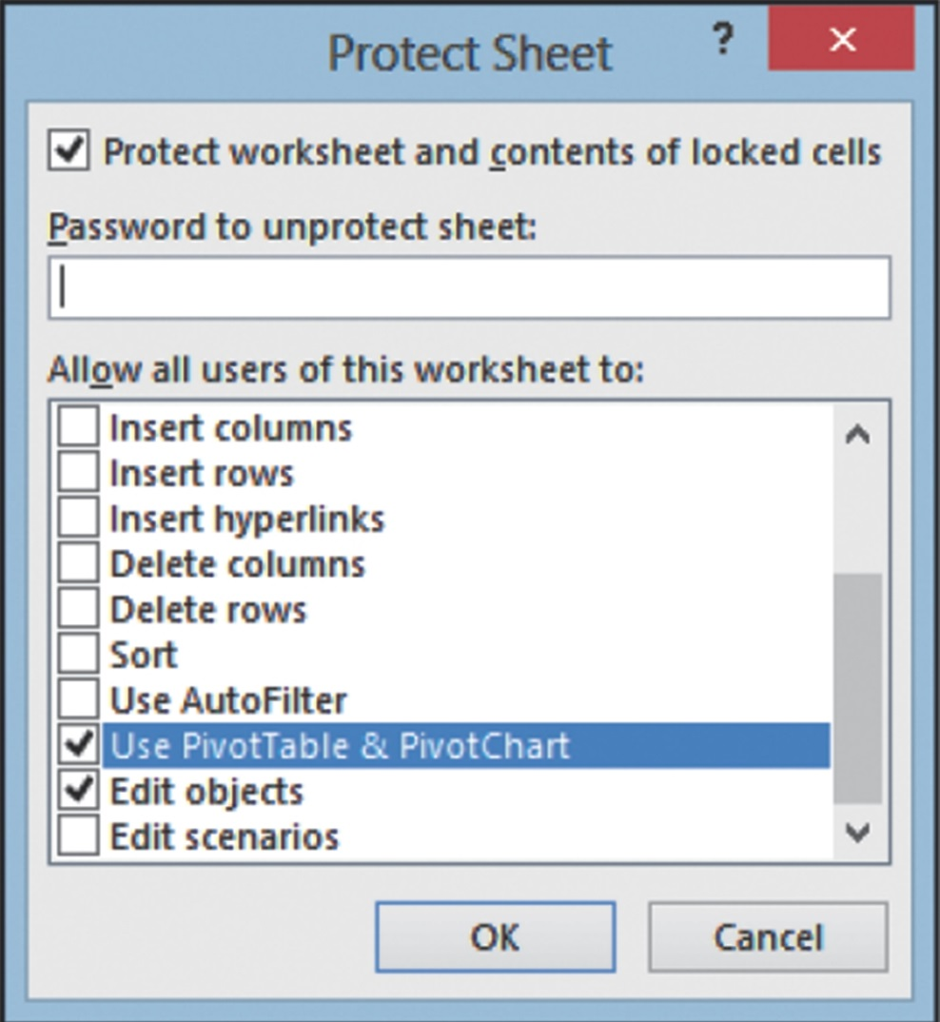
Prepare a Dashboard for Production
Notes:
Developing a dashboard is a mixture of knowledge about the business, design, and software tools to create visual information. Once you have completed a dashboard, it is important to prepare it for distribution to managers. The goal is to make it easy to use, while protecting it from accidental mistakes such as worksheet deletions or cell changes.
Protecting the worksheet keeps users from making incorrect modifications or deletions. Use the Review tab to begin the process of protecting the worksheet. On the Protect Sheet dialog box, you have the option to set a password and options for enabling the users to complete certain types of changes to the worksheet, as shown here. In some cases, the users may need to be able to make changes, such as when using a PivotTable and PivotChart.
The discussion of preparing a dashboard for production continues on the following slide.

Slide 24
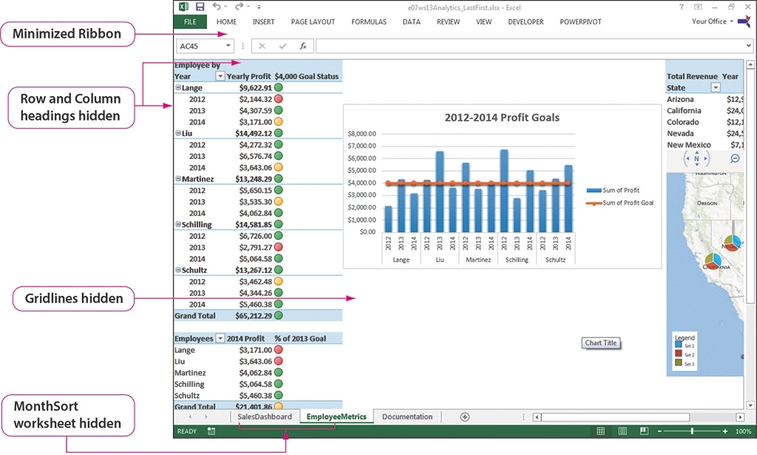
Prepare a Dashboard for Production
Notes:
With the dashboard ready for production, you can hide screen elements that are unnecessary to the utilization of the dashboard by hiding them. Controls, such as the Ribbon and scroll bars, may not be needed. Many of the changes made to the dashboard shown here were made through the Backstage view Options, using the Advanced tab under Display options. Worksheets can be hidden by right-clicking the worksheet tab and selecting Hide. Notice how uncluttered this dashboard has become by hiding elements. A word of caution about hiding scroll bars: screen sizes may prevent all of the data from being viewed, making it necessary to use the scroll bars. Keep in mind that the users may need the scroll bars.

Slide 25
Generate Visual Reports with Power View
Power View:
Data visualizations
Tables
Charts
Maps
And more
Refresh and filter data
Slicers
Microsoft Silverlight–free plug-in
Notes:
Power View, another Excel 2013 tool, enables you to provide interactive data visualization, exploration, and presentation experience to users. Through Power View, you can create reports from data that have been added to the data model, which can be refreshed to accommodate updated data or filtered as needed. Slicers are used to filter data in multiple visualizations.
The free Microsoft Silverlight plug-in is required for using Power View. You can download the plug-in from the Microsoft web site.
Information on generating visual reports with Power View continues on the next slide.

Slide 26
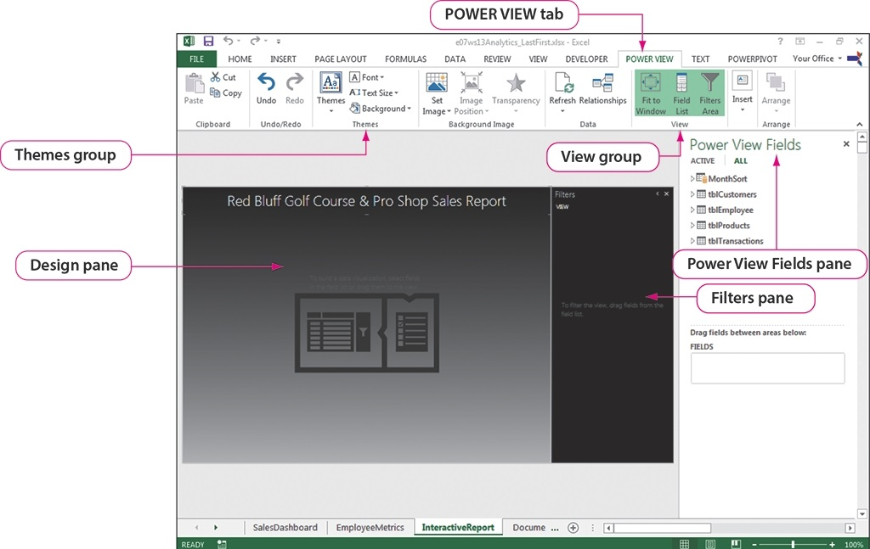
Generate Visual Reports with Power View
Notes:
After installing Microsoft Silverlight, use the Insert tab Power View button to start a Power View report. The Power View report sheet, as shown here, looks rather like a PowerPoint slide, with three panes: Design, Filters, and Power View Fields. Notice that in the figure, the data tables are shown in a collapsed list. Click the arrow next to the table to reveal the fields within the tables. Titles and themes can be added to the Power View to increase the visual appeal of the report.
More Power View report settings are discussed on the following slide.

Slide 27
Generate Visual Reports with Power View
Multiples:
Identical charts
Same x- and y-axes
Different values
Vertical multiples–width of container, wrap down, can add scroll bar
Horizontal multiples–width of container, adds scroll bar if needed
Notes:
Multiples are identical charts, with the same x- and y-axes, that display different values on a Power View report. This enables users to quickly compare the values at the same time. Vertical multiples display the charts across the width of the container, or space you allow for the charts, and wrap down if space is available. If the container does not accommodate wrapping, a vertical scroll bar is added. Horizontal multiples also display across the width of the container, with a horizontal scroll bar added if the charts exceed the size of the container.
A Power View report with horizontal multiples is shown on the next slide.

Slide 28
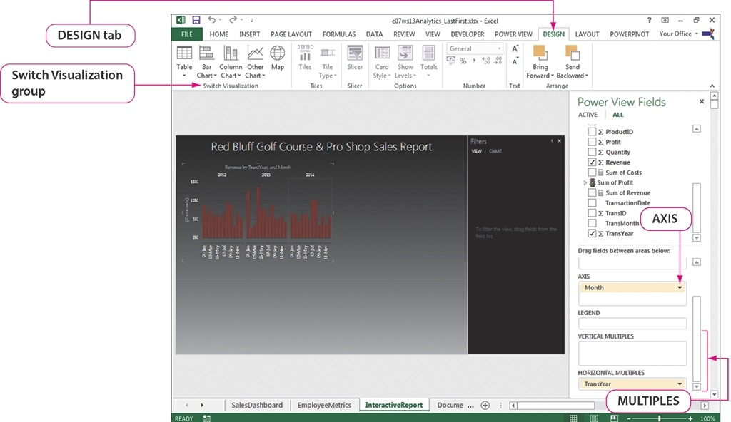
Generate Visual Reports with Power View
Notes:
This figure shows horizontal multiples added to the Power View report using the Design tab, which appears after data is selected in the Power View Fields pane and added to the Design pane. A horizontal scroll bar is not needed in this case, because the charts fit within the container. The size of the chart can be increased by pointing to the chart and clicking the Pop out icon. To return the chart to the smaller size, click the Pop in icon.
Information on generating visual reports with Power View continues on the next slide.

Slide 29
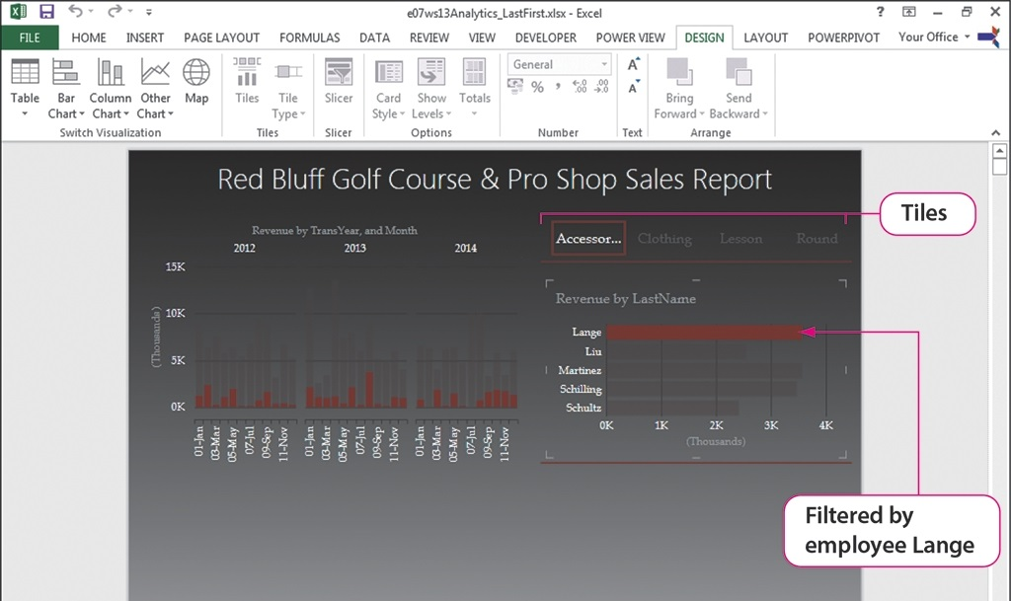
Generate Visual Reports with Power View
Notes:
Another option for displaying charts uses the visualization feature of tiles. Displayed on a dynamic navigational strip, the tiles can be selected by the user as desired, as shown here with the various product types used to create the tile titles.
Information on adding more data visualizations to the Power View report continues on the next slide.

Slide 30
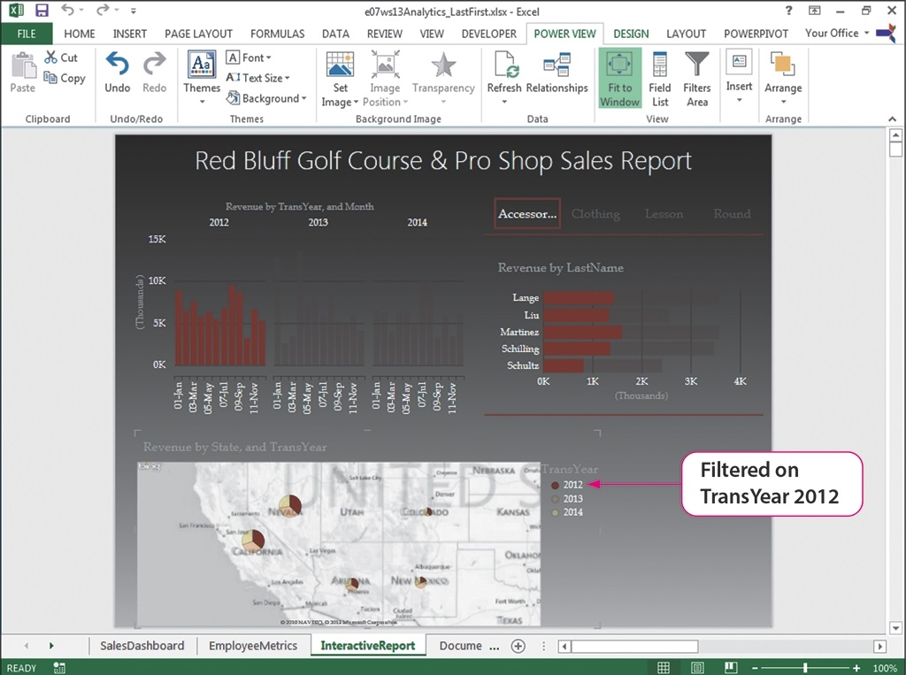
Generate Visual Reports with Power View
Notes:
Just as a Bing Map was added to a dashboard to provide a graphical view of the data, maps can also be added to the Power View report, as shown here, with filtered data represented on the map. By clicking on one of the legend items, the data is filtered to display only that item on the map.
Information on generating visual reports with Power View continues on the next slide.

Slide 31
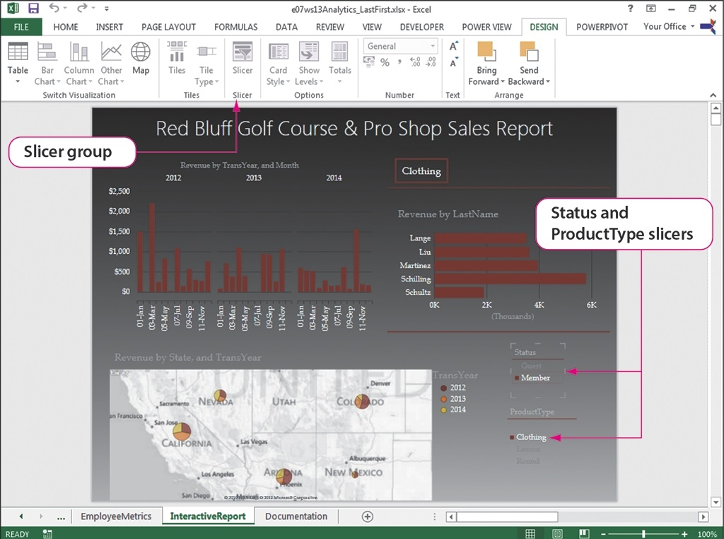
Generate Visual Reports with Power View
Notes:
You are already familiar with the power of slicers as a way to filter data and charts with a click of a button. Slicers can also be used on a Power View report to display data that is not necessarily a part of any of the visualizations. As shown here, slicers were added to the Status and ProductType fields, using the Slicer button on the Design tab.

Slide 32
Summary
Dashboards
Data models
PowerPivot:
PivotTables
PivotCharts
Apps for Office
Power View reports
Notes:
Dashboards enable managers to make decisions based on visual representations of data. Data models demonstrate the relationships between tables. Using PowerPivot, PivotTables and PivotCharts can be displayed on the same worksheet so that managers can get a better understanding of the data. Using apps for Office, dashboards can be built with elements that increase interest and provide opportunities for greater understanding of visual data. Power View reports provide a dynamic, interactive environment for working with visual business intelligence data.

Slide 33
Questions
Notes:
As you complete your study of this workshop, be sure you ask questions. Knowing how to produce visual representations of data is important in the management of business intelligence.

Slide 34
Copyright
All rights reserved. No part of this publication may be reproduced, stored in a retrieval system, or transmitted, in any form or by any means, electronic, mechanical, photocopying, recording, or otherwise, without the prior written permission of the publisher. Printed in the United States of America.

